Slide 1
Sequential Circuits
Give sequence to events
Have memory
Use feedback, from output to input, to store information
Analogous to state in programs, and is how memory is implemented in hardware
State: feedback from outputs back to inputs

Slide 2
SR Latch Analysis
S = 1, R = 0:
then Q = 1 and Q = 0
Set the output
S = 0, R = 1:
then Q = 0 and Q = 1
Reset the output
1
1
Notes:
Only true when both are 0

Slide 3
SR Latch Analysis
S = 0, R = 0:
then Q = Q_{prev}
S = 1, R = 1:
then Q = 0, Q = 0
Invalid State
should never have
Q = NOT Q
1
Memory!
Notes:
Only true when both are 0

Slide 4
D Latch
Uses SR latch and additional gates to avoid S=R=1 case
Two inputs: CLK, D
CLK: controls when the output changes
D (the data input): controls what the output changes to
Function
When CLK = 1,
D passes through to Q (transparent)
When CLK = 0,
Q holds its previous value (opaque)
Avoids invalid case when
Q = NOT Q

Slide 5
D Latch Internal Circuit

Slide 6
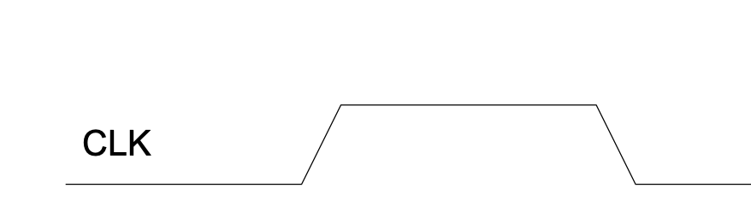
D Latch
When CLK = 1,
Data is allowed to flow
D passes through to Q (transparent)
When CLK = 0,
Data cannot pass through
Q holds its previous value (opaque)
transparent
opaque
opaque

Slide 7
D Flip-Flop Internals
Two back-to-back D latches (L1 and L2) controlled by complementary clocks
When CLK = 0
L1 is transparent
L2 is opaque
D passes through along N1
When CLK = 1
L2 is transparent
L1 is opaque
N1 passes through to Q
Thus, on the edge of the clock (when CLK rises from 0 1)
D passes through to Q
D flip-flop copies D to Q on the rising edge of the clock, and remembers its state at all other times.

Slide 8
D Flip-Flop
Inputs: CLK, D
Function
Samples D on rising edge of CLK
When CLK rises from 0 to 1, D passes through to Q
Otherwise, Q holds its previous value
Q changes only on rising edge of CLK
Called edge-triggered
Activated on the clock edge

Slide 9
Parallelism Definitions
We define a token to be a group of inputs that are processed to produce a group of outputs.
The latency of a system is the time required for one token to pass through the system from start to end.
The throughput is the number of tokens that can be produced per unit time.

Slide 10
Parallelism Definitions
Throughput can be improved by processing several tokens at the same time – this is parallelism
Equation relating latency and throughput: T = 1/L
This assumes no parallelism – it becomes T = N/L as we incorporate a total of N stages (which we’ll discuss soon)

Slide 11
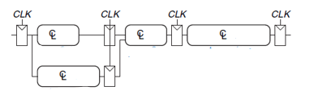
Pipelining
Pipelining is particularly attractive because it speeds up a circuit without duplicating the hardware.
Instead, registers are placed between blocks of combinational logic to divide the logic into shorter stages that can run with a faster clock.

Slide 12
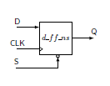
D Flip-Flop Example
Write the Hardcaml code that describes a D flip-flop shown above. Consider the R (reset) input to be an active-high, asynchronous input that resets the D flip-flop output to 0 when asserted.
This R does not depend on the clock, which is what asynchronous means in this context.

Slide 13
D Flip-Flop Input Options
Outside of the previous mentioned reset, we have a few other Hardcaml options (more are occasionally used in other settings as well):
When enable=1: Output q takes the value of input d on the clock edge (this is essentially normal behavior!)
When enable=0: Output q maintains its current value (this disables the flip-flop!)
Synchronous clear: A different type of reset that follows synchronous/clocked behaviors setting q to 0 on the next clock edge when clear is high

Slide 14
Priority Selector Example
Now that we have access to a clock in general, it makes more sense to start thinking about timing considerations. As we saw with multiplexers last week, larger muxes require more gates to build, which can cost more time during implementation as well. However, there is another side to this which we can see in the following example high-level code:
if a then v
else if b then w
else if c then x
else if d then y
else z
Maybe not obvious but these can all be implemented via muxes!

Slide 15
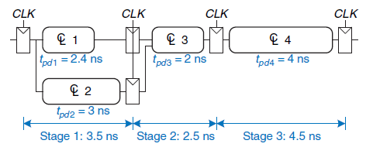

Today’s Tasks
Implement a pipelined circuit with at least three stages. You should use the below diagram as a guideline (replacing the CL aka combinational logic blocks with your choice of combinational logic) but are free to add stages or otherwise experiment as you see fit

Slide 16
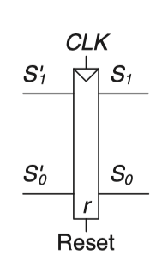

Today’s Tasks
Given the diagram shown below, identify equations for each output (LA1, LA0, LB1, LB0) as well as the intermediate values S1’ and S0’. Implement your findings in Hardcaml!

Slide 17
Some helpful course pages
https://hardcaml-mini-course-at-stevens.github.io/hardcaml-docs/designing-circuits/combinational_logic
https://hardcaml-mini-course-at-stevens.github.io/hardcaml-docs/designing-circuits/sequential_logic
https://hardcaml-mini-course-at-stevens.github.io/hardcaml-docs/designing-circuits/d_flip_flop

